Slide 1
Scientific and Graphing Calculator
Name : Ruzhan Reaz Suham Roll : 1522
GitHub Link :
Supervisor : Dr. Md. Mahbubul Alam Joarder
https://github.com/ruzhanreaz/SPL-1

Slide 2
Project Overview
Scientific calculator implementation in C
Interactive menu-driven interface
Support for multiple calculation modes

Slide 3
Core Features
Currently Implemented:
Expression evaluation
Trigonometric functions with degree/radian support
logarithmic functions(base 10 and base e)
Mathematical constants (pi, e)
Linear equation systems solver
Error handling

Slide 4
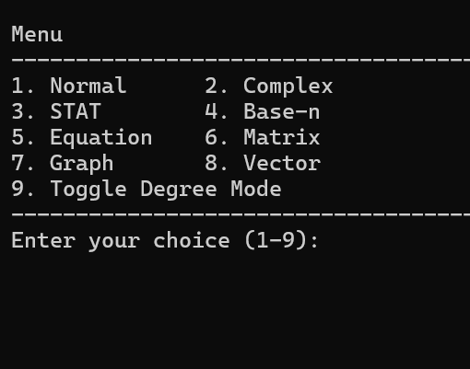
Calculator Modes
1. Normal Mode
2. Complex Mode
3. STAT Mode
4. Base-n Mode
5. Equation Mode
6. Matrix Mode
7. Graph Mode
8. Vector Mode
9. Toggle Degree Mode

Slide 5
Normal Mode Features
Expression Handling:
Arithmetic operations (+, -, *, /, ^)
Trigonometric functions (sin, cos, tan, asin, acos, atan)
Logarithmic functions (log, ln)
Exponential (exp)
Constants (p, e)
Percentage calculations

Slide 6
Expression Processing
1. Tokenization:
Parses input string into tokens
Handles numbers, operators, functions
Validates syntax and input
2. Infix to Postfix Conversion:
Operator precedence handling
Function and parentheses support

Slide 7
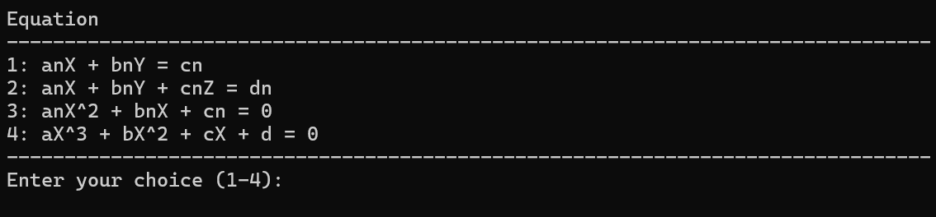
Equation Solver System
2 Variable linear equations:
a1x + b1y = c1
a2x + b2y = c2
3 Variable linear equations:
a1x + b1y + c1z = d1
a2x + b2y + c2z = d2
a3x + b3y + c3z = d3

Slide 8
Development Roadmap
Planned Features:
Graph Mode
Complex number operations
Statistical calculations
Matrix and vector operations

Slide 9
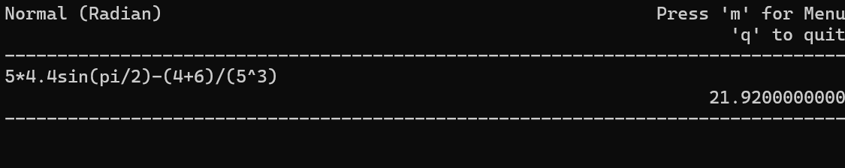
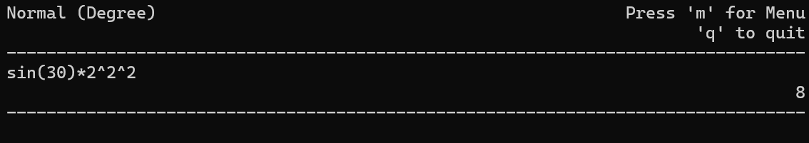
Demo
1. Normal Mode Operations:

Slide 10
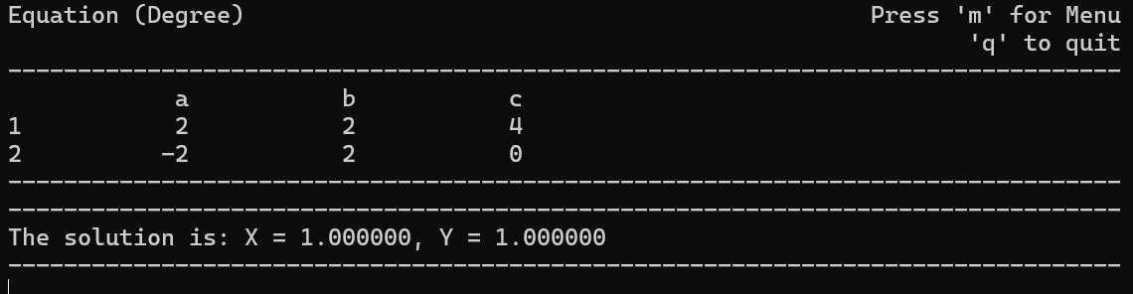
Demo
2. Equation Solver:

Slide 11
Thank You

